Slide 1
Ndûva
MVP & USER JOURNEY

Slide 2

Homepage
The starting point where users land when they click on the website.
Users are presented with two options: to proceed as a 'Learner' or a 'Teacher'.

Slide 3
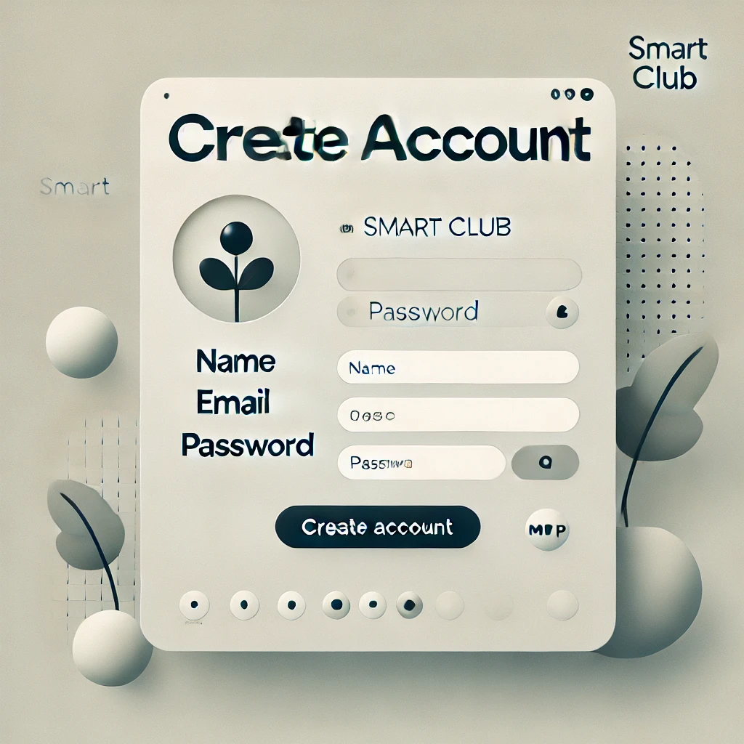
Account Creation
If a user selects 'Learner', they are guided to create an account.

Slide 4

AI-Enhanced Learning Information
Users fill out information to tailor the learning experience using AI.

Slide 5
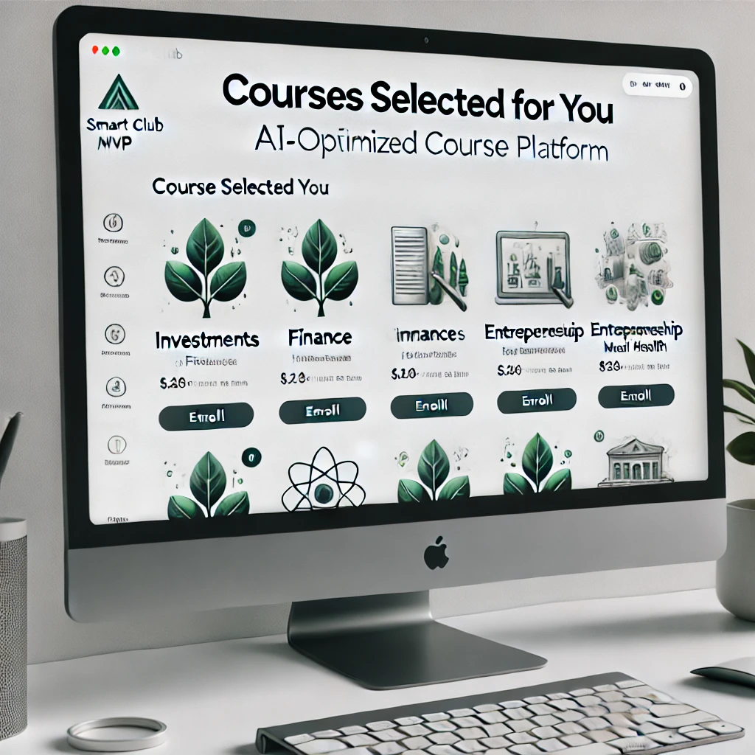
Course Selection
Learners receive AI-optimized course recommendations to choose from based on the information they provided.

Slide 6
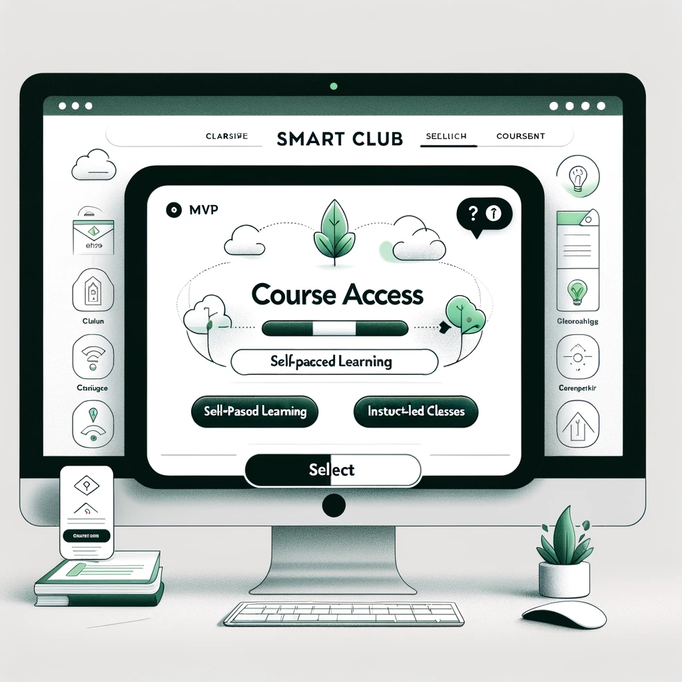
Course Access
Learners have the option to engage in self-paced learning or join instructor-led
classes at scheduled times.

Slide 7
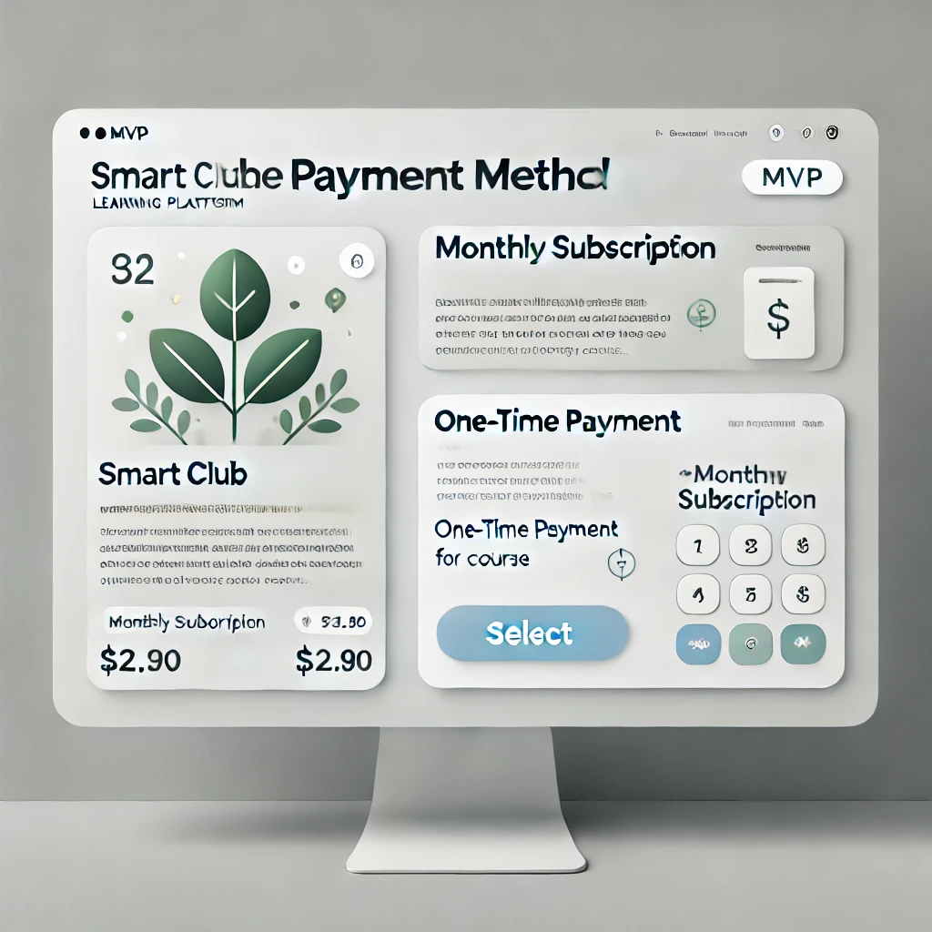
Payment Method
Users can choose between a monthly subscription
or a one-time payment for course access.

Slide 8

Dashboard Setup
The learner's personalized dashboard is created,
providing an overview of their courses and progress.

Slide 9

In classroom
Leaner accesses classroom with weekly progress check on courses and tests.

Slide 10

Course Completion
Upon finishing a course, learners receive a certificate and grades.

